Slide 1

PWM Motor Control with IFI Robotics Victor884
Electronic Speed Controller
David Giandomenico
Lynbrook High School Robotics
FIRST Team #846
DGiandomenico@lynbrookrobotics.com
(408)343-1183

Slide 2
Linear Speed Control
Simple Linear Speed Control uses a fixed voltage source and variable resistance† in series with the motor to control the applied voltage
Voltage not delivered to the motor is dropped across the variable resistance.
Inefficient whenever <100% voltage is applied
† The series pass element, here described as a “variable resistance,” would commonly be a power transistor controlled with a regulator circuit.

Slide 3
Switching Speed Control
Control power to the motor by rapidly opening and closing a switch connected to a fixed voltage source.
Ideal switch doesn’t dissipate power
  Power in an ideal switch is zero, since either the current through the switch is zero, or the voltage across the switch is zero .

Slide 4
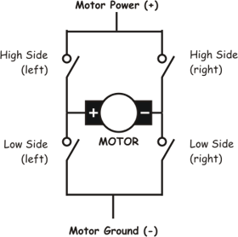
Basic H-Bridge
www.mcmanis.com/.../images/basic-bridge.gif

Slide 5
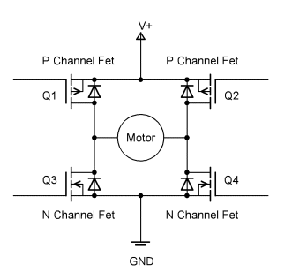
Basic MOSFET H-Bridge
roko.ca/articles/hbridge/bridge1.gif

Slide 6
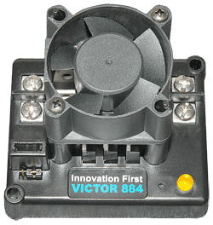
IFI-Robotics Victor 884
Electronic Speed Controller (ESC)
Full H-Bridge, composed of 4 groups of 3 IRL3103 MOSFETs, each rated at 45A continuous at T=100C
www.ifirobotics.com/.../victor-884-250-a.gif

Slide 7
Pulse Width Modulation
PWM – A general method of conveying power or data by varying the duty cycle† of a square wave to convey either power or data.
  †Duty cycle is the percentage of time the square wave is ‘high’.
FIRST Robotics uses the PWM method to two ways:
  Send control data to IFI Robotics Victor88x Series Electronics Speed Controllers (ESC’s), common hobby servos, etc.
  Deliver switched power from Victor Series ESC’s to motors.

Slide 8
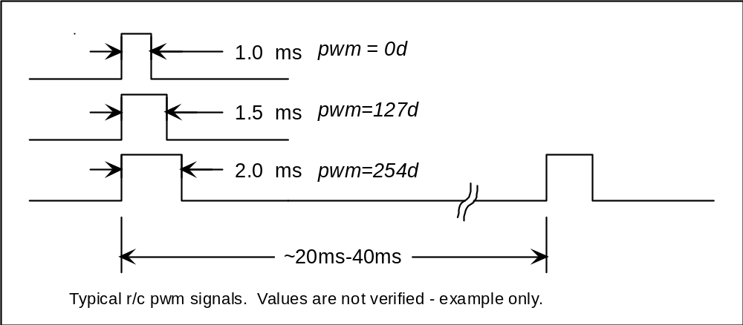
PWM Method of Data Transfer to Servos and Victor ESCs
25X/sec to 50X/sec

Slide 9
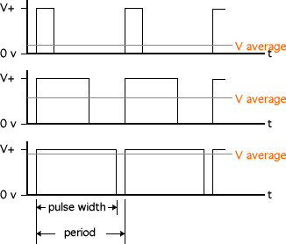
PWM Method of Power Delivery used by
IFIRobotics Victor884 ESCs
Duty Cycle
~20%
~60%
~90%
f = 120Hz, T=1/f =8.3ms
for Victor884 ESC only
www.societyofrobots.com/images
PWM technique varies the duty cycle of a square wave signal.

Slide 10
Linear vs. PWM/Switched Motor Control
Simple Linear | PWM/Switched
Control Method: Vary Applied Voltage | Control Method: Vary Duty Cycle
Inefficient | Efficient
Motor Speed is proportional to applied voltage | Motor speed is not linearly proportional to duty-cycle
Current draw is continuous | High peak currents at low duty cycle; Not continuous.
Good speed regulation | Poor speed regulation
Efficiency is the reason we use switched power controls.

Slide 11
How does switched/PWM power control adversely affect your robot?
Robot drive system is not linearly proportional to driver’s input at the joystick.
Poor motor speed regulation when load changes when using a switched ESC (e.g. Victor884) to set a constant speed on a system such as a ball conveyor, or robotic arm.
Closed loop systems (controlled motor speed systems with feedback) will either not be stable at low speeds, or sluggish at high speeds.

Slide 12
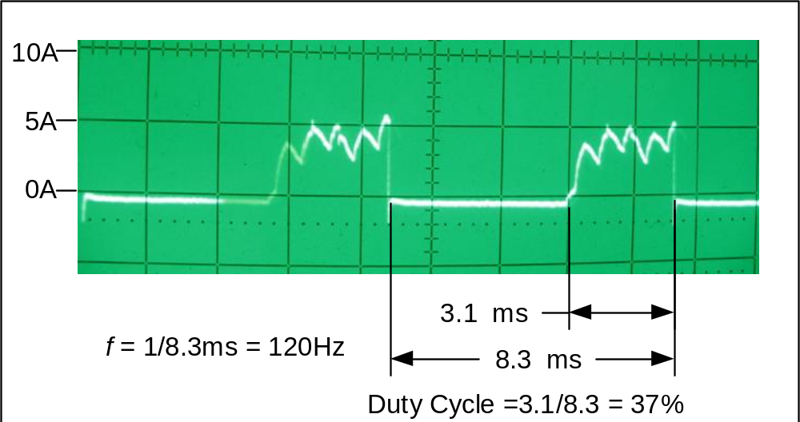

Motor Current using an
IFI Robotics Victor884 ESC
2006 Fisher Price Motor

Slide 13
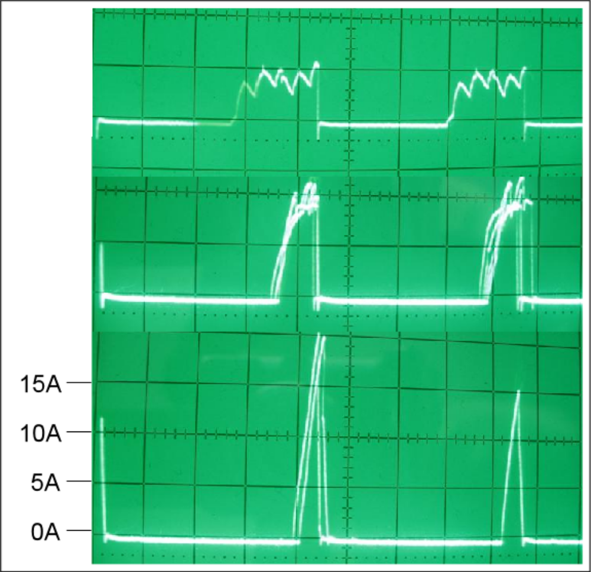
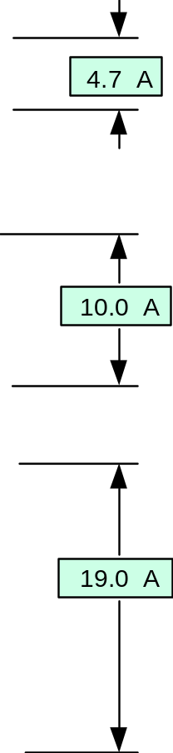
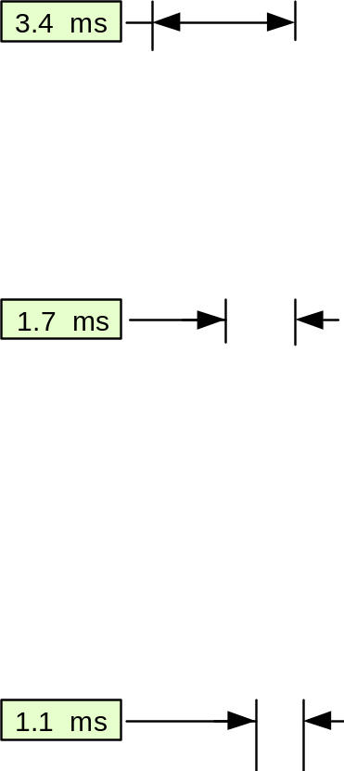
Motor Current vs. Pulse Width
As duty cycle decreases,
motor slows, causing the motor’s EMF to drop, and
the peak current to rise.
2006 Fisher Price motor turning “ball launcher” wheels.
2ms/div

Slide 14
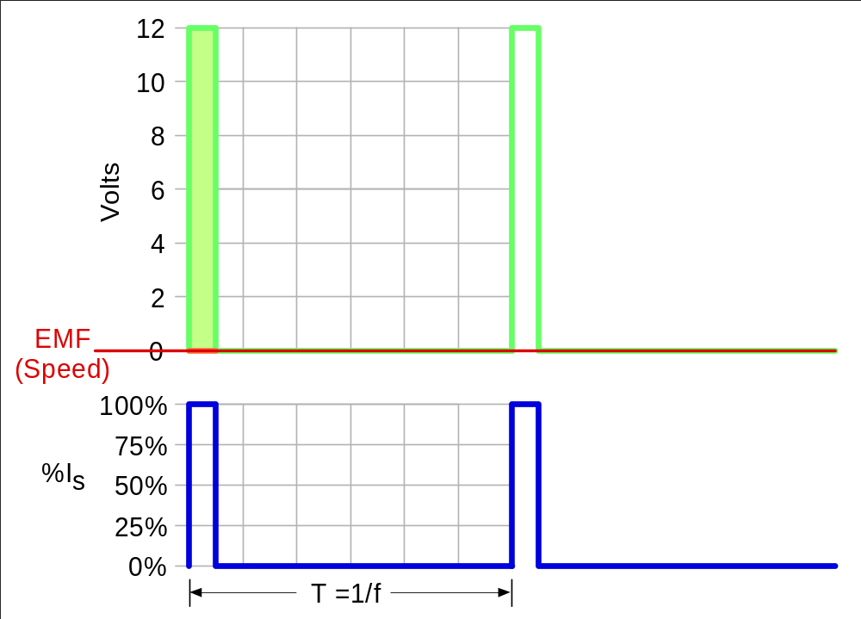
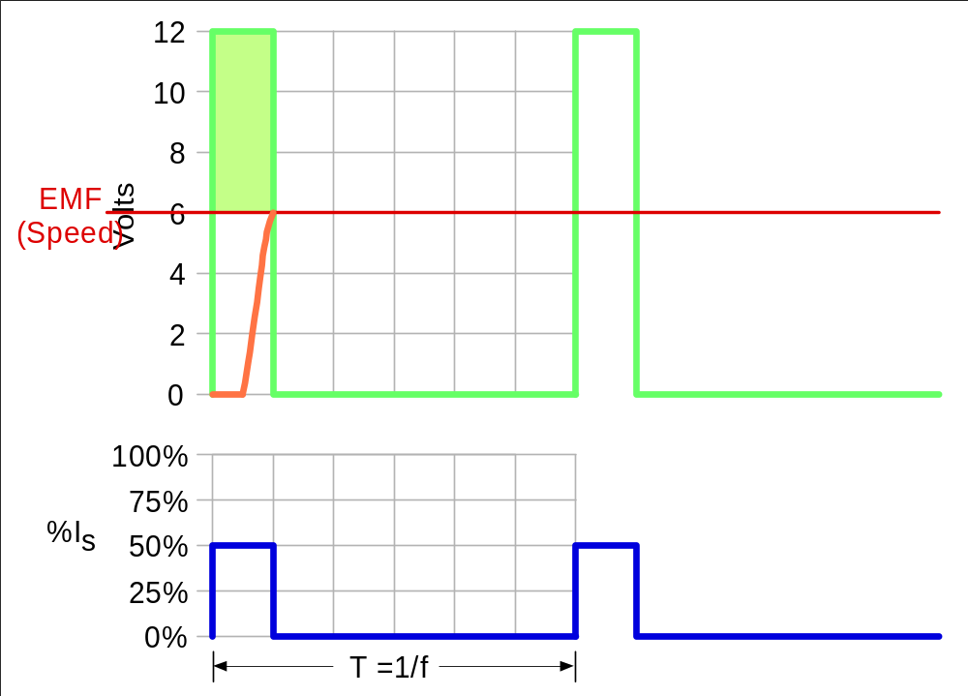
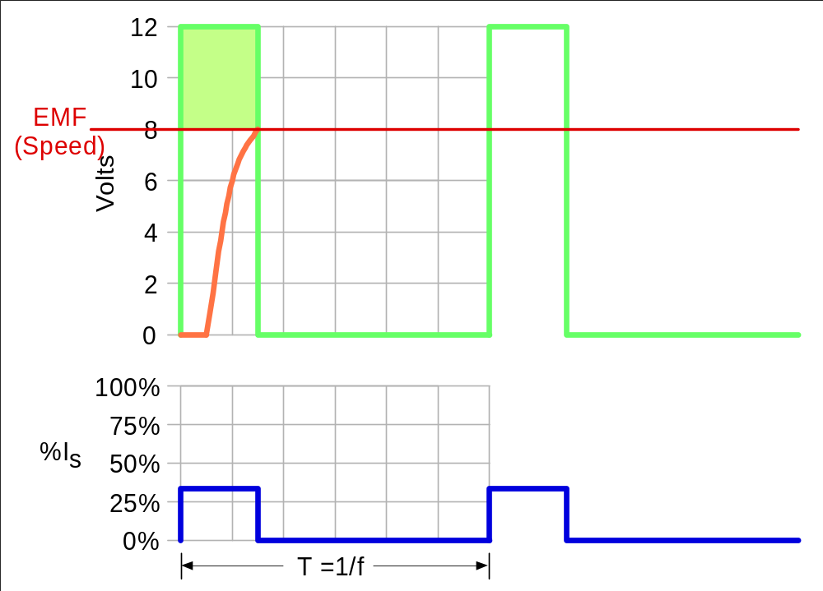
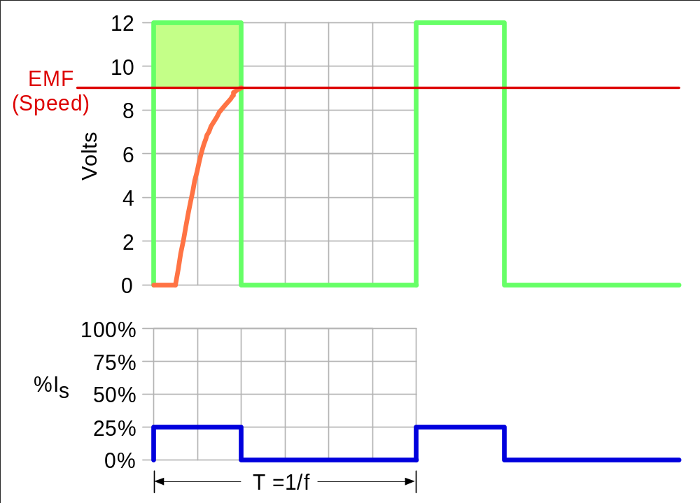
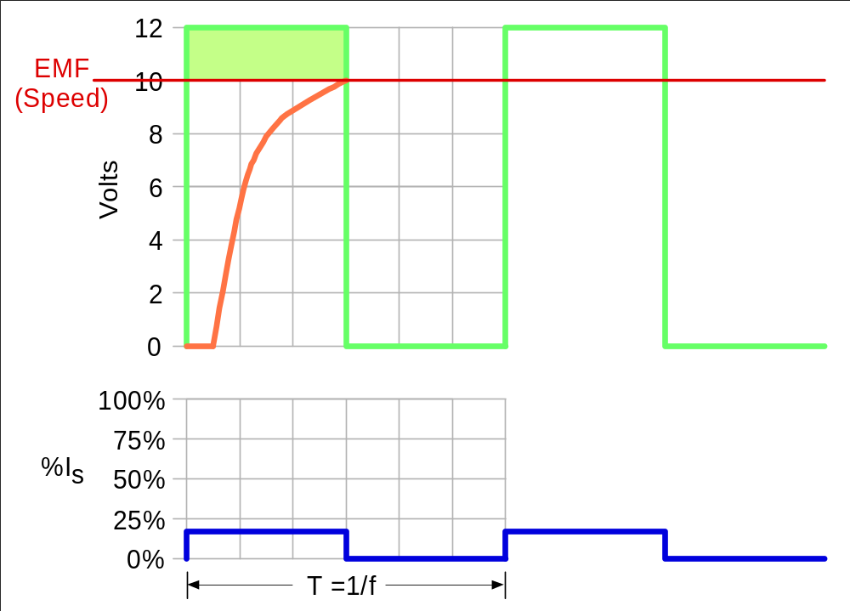
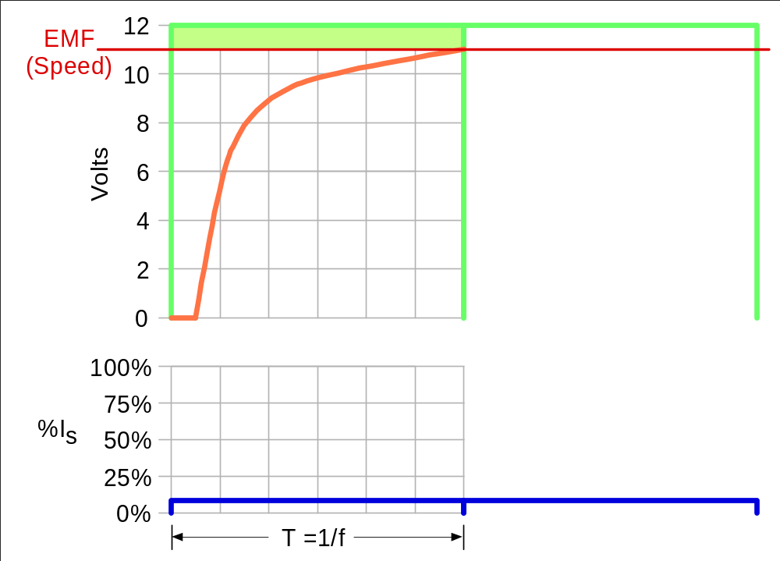
Motor EMF (Speed) vs. Duty Cycle
With a constant load, the average torque over period T is constant.
Torque = K_{i} I,
∴ average I is also constant.
I_{avg}=DC x (12V – EMF)/R
with DC ≡ t_{p}/T
So, for a constant load, the green area must be constant.

Slide 15
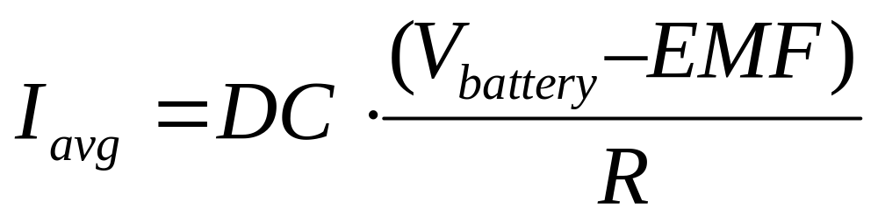
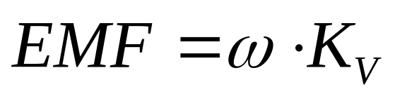
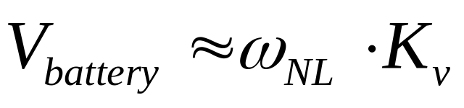
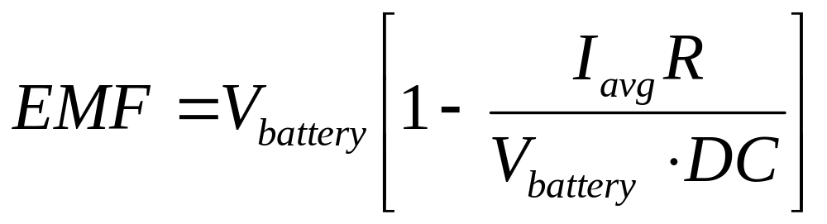
The Math
and

Slide 16
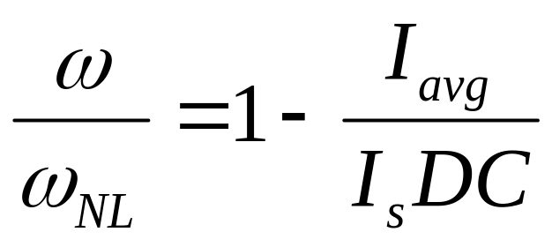
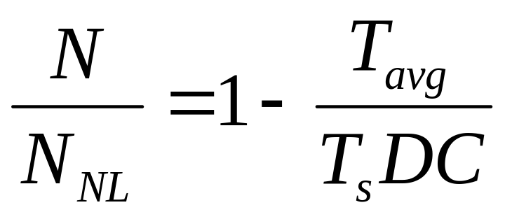
The Math (continued)

Slide 17
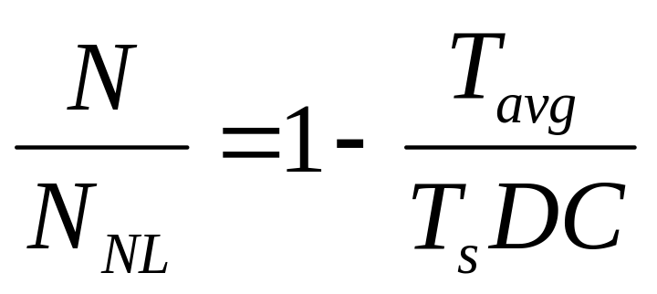
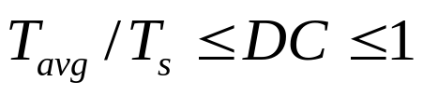
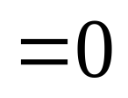
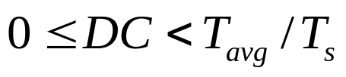
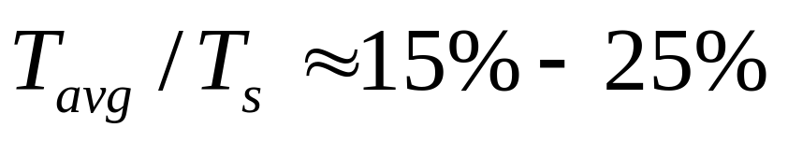
Steady State Speed as a
Function of Duty Cycle
For a typical system designed for good operating efficiency,

Slide 18
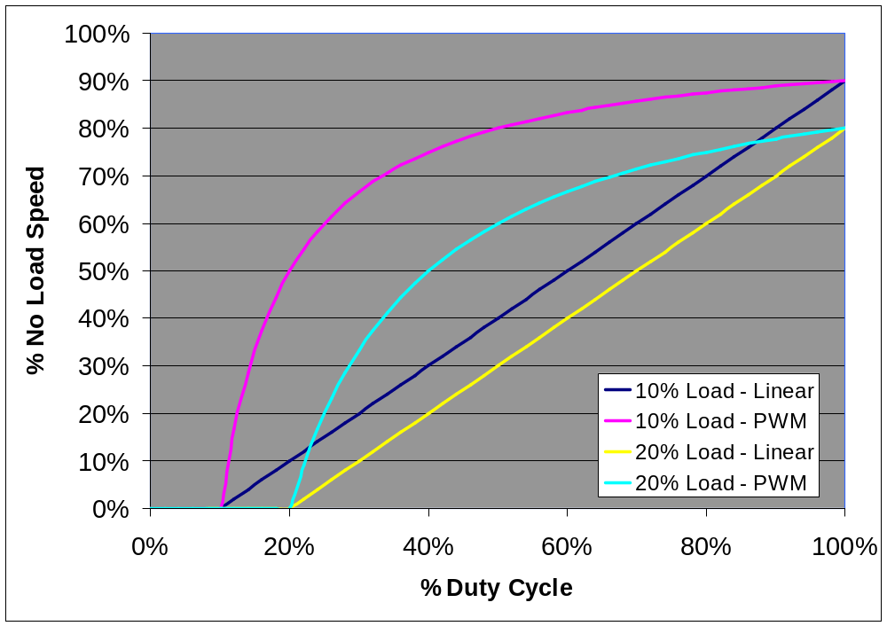
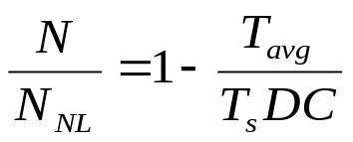
Steady State Motor Speed for
Linear and Switched/PWM Power

Slide 19
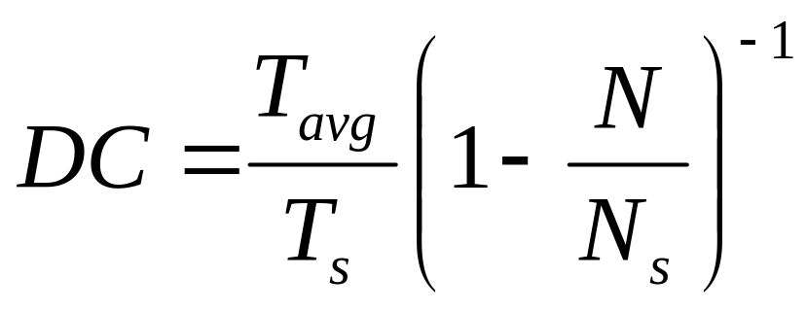
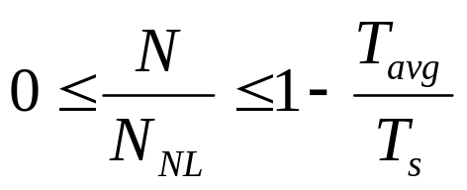
Duty Cycle vs. Steady State Speed

Slide 20
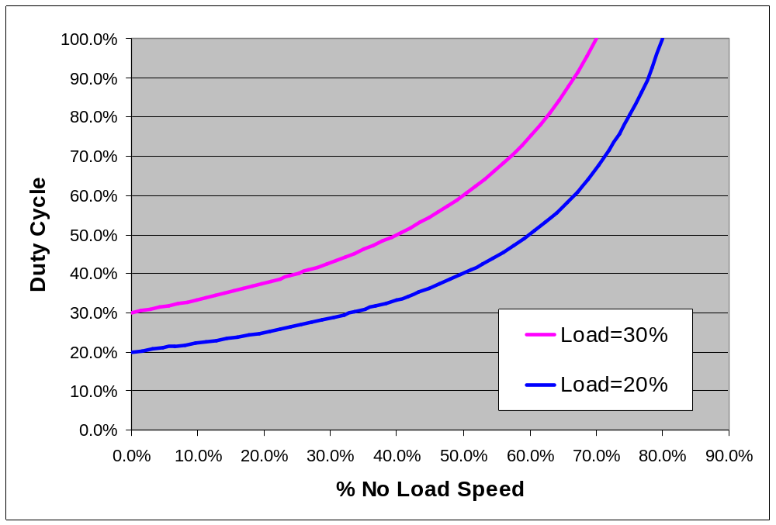
Duty Cycle vs. Speed

Slide 21
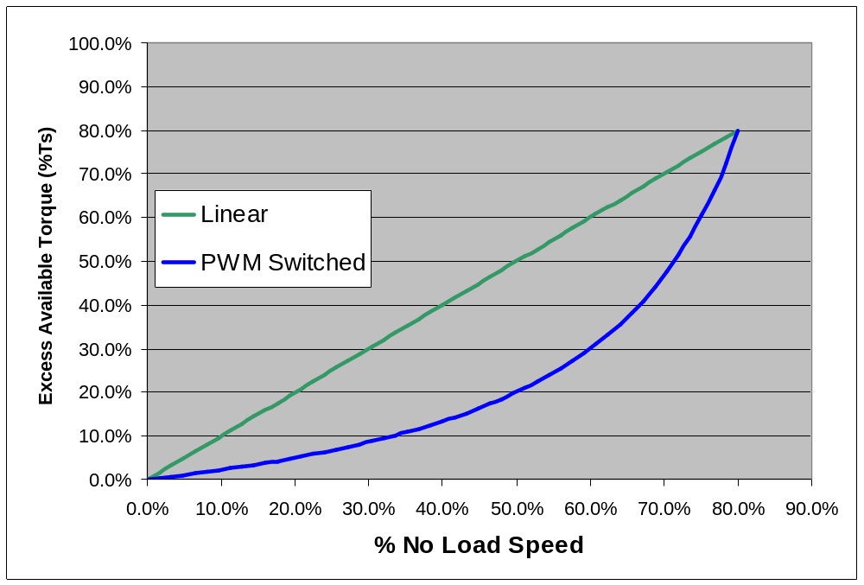
Excess Available Torque for Linear and PWM-Switched Speed Control
Load=20%T_{s}

Slide 22
Solutions for adverse affects of switched/PWM power
Robot drive system is not linearly proportional to driver’s input at the joystick.
Solution: 1) Driver compensates.
or 2) Use closed-loop control.
Poor motor speed regulation when load changes when using a switched ESC (e.g. Victor884) to set a constant speed on a system such as a ball conveyor, or robotic arm.
Solution: 1) Use gears or other speed reducer to pick speed.
or 2) Use closed-loop control.
Closed loop systems (controlled motor speed systems with feedback) will either not be stable at low speeds, or sluggish at high speeds.
Solution: Reduce proportional gain when speed is low.

Slide 23
PWM Motor Control with IFI Robotics Victor884
Electronic Speed Controller
David Giandomenico
Lynbrook High School Robotics
FIRST Team #846
DGiandomenico@lynbrookrobotics.com
(408)343-1183

